Slide 1



BMW Sales Analysis using SQL and Power BI Objective:
To analyze BMW car sales data to understand regional performance, fuel type trends, and yearly sales patterns using SQL for data analysis and Power BI for visualization.
BY JAYESH KADOS

Slide 2

Business Problems & Objectives BMW’s global sales data shows varying performance across regions, fuel types, and model years. However, key questions remain unanswered
Which regions are driving the highest and lowest sales volumes?
What fuel types contribute most to overall sales performance?
How have sales volumes evolved over time, and what patterns emerge?
Do price and mileage significantly impact customer buying behavior?
Which model years show peak sales activity?
How does engine size vary across different regions and models?
What are the color preferences among BMW buyers?
Is there a shift toward electric and hybrid vehicles compared to traditional fuels?
How do transmission types (manual vs automatic) affect sales trends?
Which regions demonstrate consistent growth or decline over the years?

Slide 3

Objectives To derive actionable insights that can guide BMW’s strategic decisions
Analyze regional and model-wise performance trends.
Identify customer preferences by fuel type, color, and transmission.
Evaluate the relationship between price, mileage, and sales.
Track sales evolution over time and highlight growth opportunities.
Support data-driven recommendations for marketing and production planning.

Slide 4

Highest sales region
select Region,sum(Sales_volume) highest_sales_region
from bmw_sales
group by Region
order by highest_sales_region desc
Limit 1;

Slide 5

Top Fuel Type by Sales
select Fuel_Type,sum(Sales_volume) highest_sales_region
from bmw_sales
group by Fuel_Type
order by highest_sales_region desc
limit 1;

Slide 6
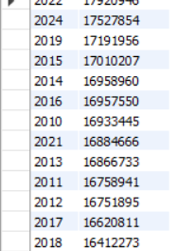
Yearly Sales Trend
select Year,sum(Sales_volume) yearly_sales
from bmw_sales
group by Year
order by yearly_sales;

Slide 7
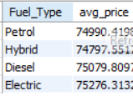
Avg Price per Fuel Type
select Fuel_Type,avg(Price_USD) as avg_pricefrom
bmw_sales
group by Fuel_Type;

Slide 8
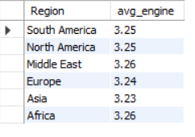
Avg Engine Size by Region
select Region,round(avg(Engine_Size_L),2) as avg_engine
from bmw_sales
group by Region
order by Region desc;

Slide 9
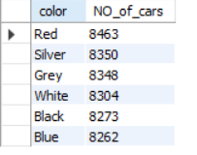
Most Popular Color
select color,count(*) as NO_of_cars
from bmw_sales
group by color
order by NO_of_cars desc;

Slide 10

Top 3 Selling Model
select Model,sum(Sales_Volume) total_sales
from bmw_sales
group by Model
order by total_sales desc
limit 3;

Slide 11
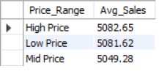
Average Price vs Sales Relationship
SELECT
CASE
WHEN Price_USD < 60000 THEN 'Low Price'
WHEN Price_USD BETWEEN 60000 AND 100000 THEN 'Mid Price'
ELSE 'High Price'
END AS Price_Range,
ROUND(AVG(Sales_Volume), 2) AS Avg_Sales
FROM bmw_sales
GROUP BY Price_Range
ORDER BY Avg_Sales DESC;

Slide 12
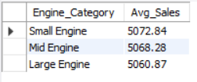
Engine Size vs Sales
SELECT
CASE
WHEN Engine_Size_L < 2.5 THEN 'Small Engine'
WHEN Engine_Size_L BETWEEN 2.5 AND 4.0 THEN 'Mid Engine'
ELSE 'Large Engine'
END AS Engine_Category,
ROUND(AVG(Sales_Volume), 2) AS Avg_Sales
FROM bmw_sales
GROUP BY Engine_Category
ORDER BY Avg_Sales DESC;

Slide 13
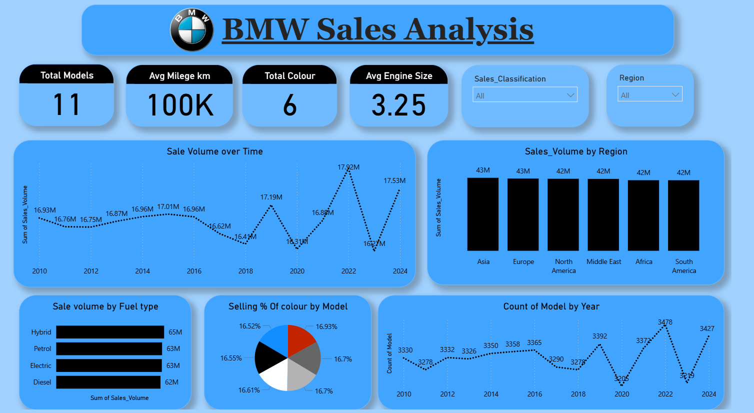

Slide 14
Conclusion & Recommendations
Conclusion & Recommendations
Conclusion
The analysis of BMW’s sales data revealed that Hybrid and Petrol models dominate total sales volume, showing a steady shift toward fuel efficiency.
Automatic transmission cars outperform manual ones, indicating a customer preference for comfort and convenience.
Mid-priced models ($60K–$100K) achieve the best sales, suggesting an optimal pricing window for profitability.
Asia and Europe lead in overall sales, confirming BMW’s strongest market presence.
Low-mileage and mid-engine (2.5 L–4.0 L) cars perform better, balancing performance with efficiency.
Sales dipped during pandemic years but recovered strongly after 2022, reflecting post-crisis growth.
Recommendations
Focus marketing efforts on Hybrid + Automatic models in top-performing regions (Asia & Europe).
Position more models in the $60K–$100K range to maximize conversion and revenue.
Enhance production of mid-engine vehicles, which have the highest sales consistency.
Promote popular colors (Blue & White) to align with customer preferences and brand identity.
Expand EV strategy by introducing competitively priced electric models to capture growing market interest.

